Slide 1
Cinema booking system
Presented by: Tsoodol, Enkh-Amgalan

Slide 2
Technologies
JSP
MySQL
Java FX
MVC Framework (hand organized)
Tomcat 7
Github
Staruml
Bootstrap

Slide 3
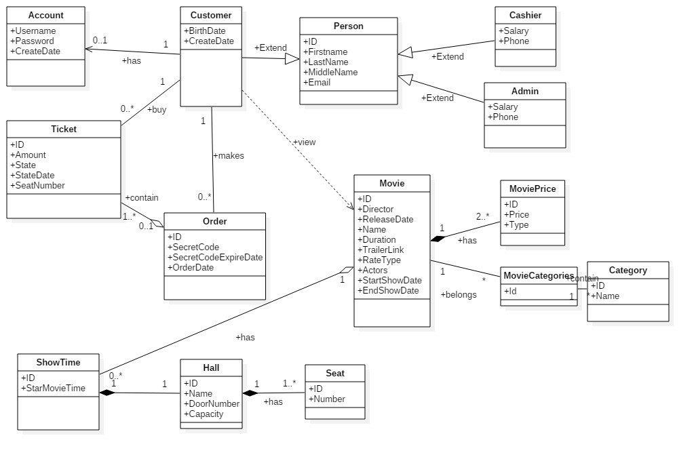
Class diagram (Inheritance and Associations)

Slide 4
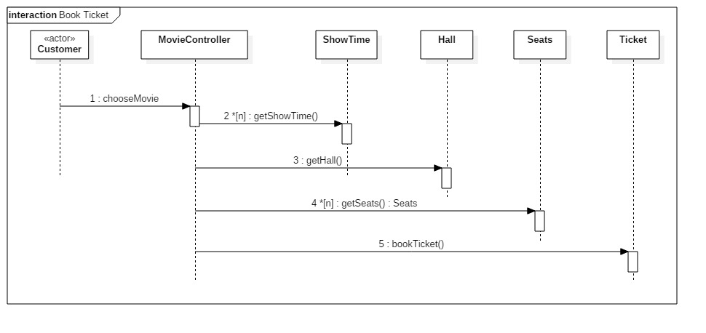
Book ticket

Slide 5
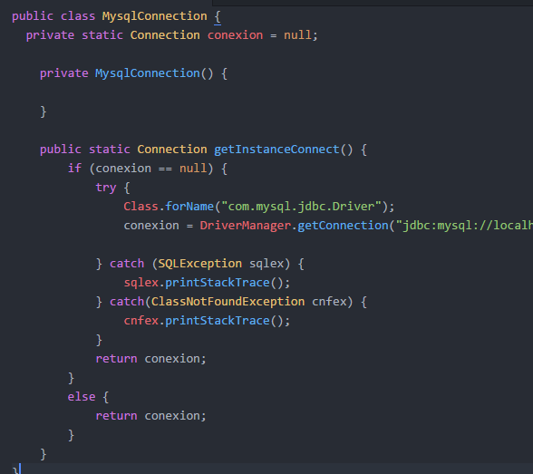
Singleton
Database connection
Get instances on the controller
Static method in the class

Slide 6


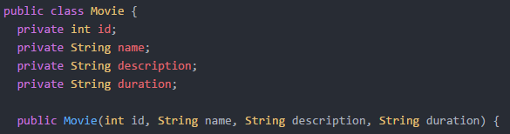
MVC
Rendering movie list in JSP
Stores all movie in the movie List in Array List
Movie model that shows data stores in the Movie

Slide 7
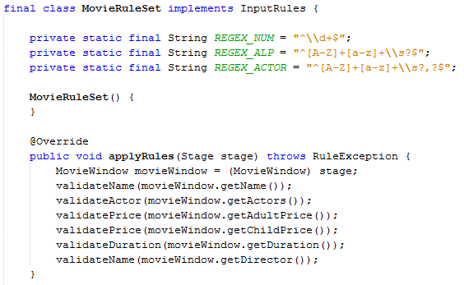
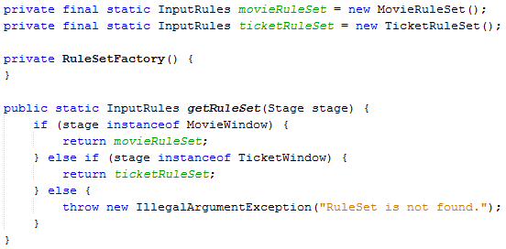
Parametrized factory design
Validate inputs of the form “TicketWindow”
Validate inputs of the form “MovieWindow”

Slide 8
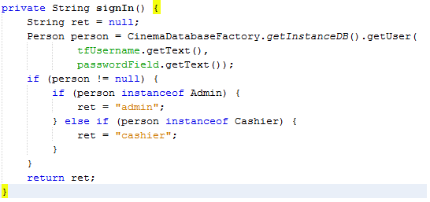
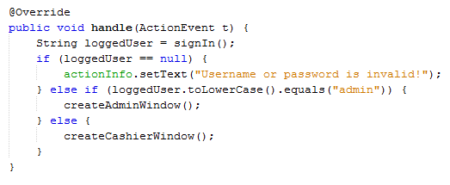
Polymorphism
System has three kind of actors. These are: Admin, Cashier, and Customer
They all inherit from class “Person”

Slide 9
Thank you for attention!

